Slide 1
Video Game Sales Data Analysis
By Nigel

Slide 2
Summary
Over the past couple of decades, video games has been rising in popularity among youths, and even adults throughout the world. In this project, a data analysis will be done on the sales of video games to evaluate the sales of video games throughout different countries.

Slide 3
Table of contents
01
Problem Statement
04
Insights & Recommendation
02
Data Preparation
05
Project stages
03
Data Analysis
06
Our team

Slide 4
01
Problem Statement
You can enter a subtitle here if you need it

Slide 5
Problem Statement
Which genres are more popular? Do they differ in each region?
Which video game platforms are more popular?
Which specific games are most popular?
How can video gaming companies boost their sales using the data analyzed?

Slide 6
02
Data Preparation & Processing
You can enter a subtitle here if you need it

Slide 7
Data Preparation
The dataset used is from Kaggle - https://www.kaggle.com/datasets/gregorut/videogamesales
As mentioned by the author, the dataset was scrapped from the website www.vgchartz.com, using the Python script BeautifulSoup.
The fields of the dataset include:
Rank - Ranking of overall sales
Name - The games name
Platform - Platform of the games release (i.e. PC,PS4, etc.)
Year - Year of the game's release
Genre - Genre of the game
Publisher - Publisher of the game
NA_Sales - Sales in North America (in millions)
EU_Sales - Sales in Europe (in millions)
JP_Sales - Sales in Japan (in millions)
Other_Sales - Sales in the rest of the world (in millions)
Global_Sales - Total worldwide sales

Slide 8
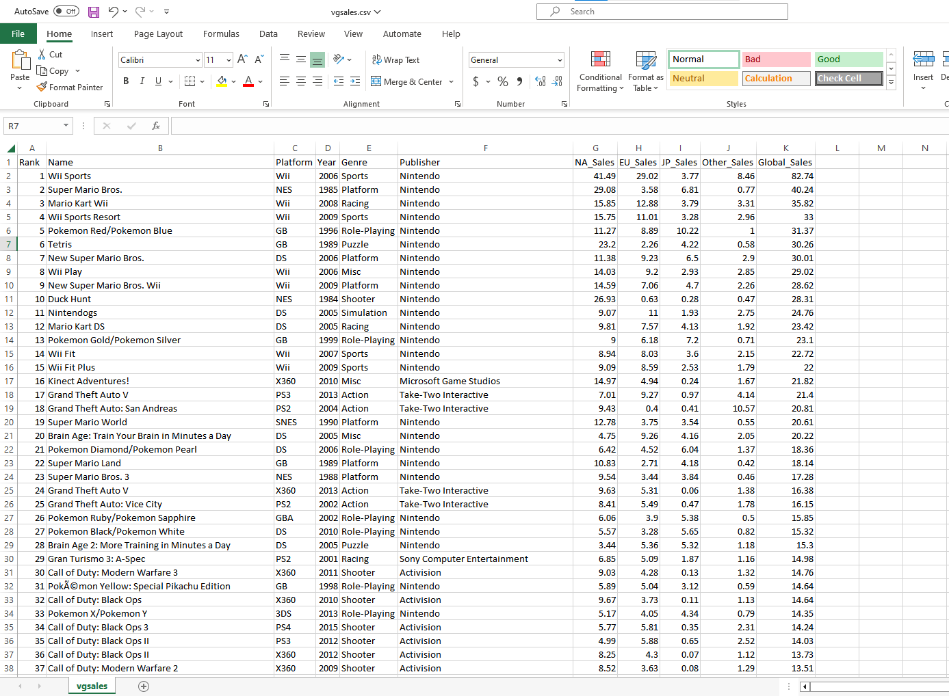
Data Processing (Excel Overview)

Slide 9
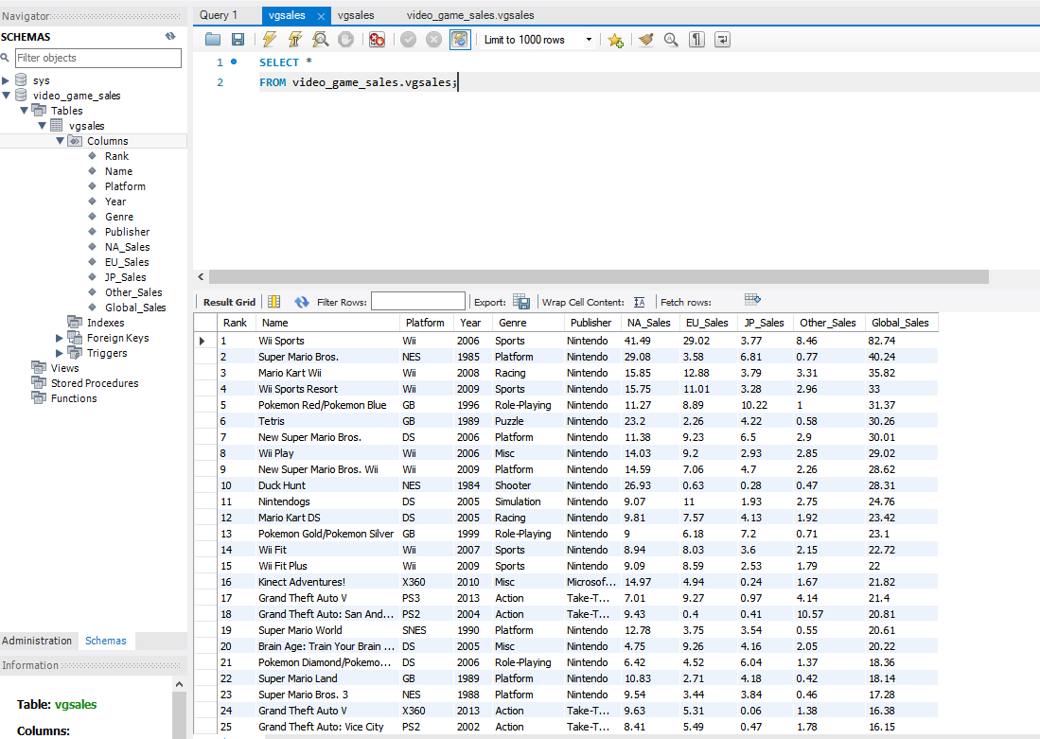
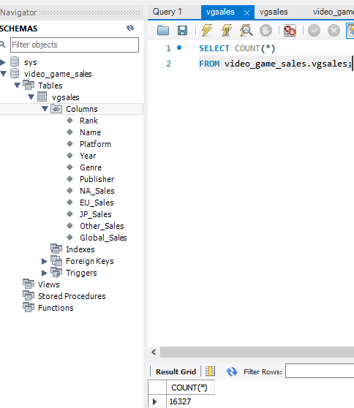
Data Processing (SQL Overview)
As this is a large dataset (16,327 rows), we will mainly be using SQL to process the data (mySQL).

Slide 10

Data Processing (mySQL)
REMOVING DUPLICATES
The following query helps to identify duplicates in the ‘Name’, ‘Platform’ and ‘Year’ column:
SELECT
Name, COUNT(Name),
Platform, COUNT(Platform)
Year, COUNT(Year)
FROM
video_game_sales.vgsales
GROUP BY
Name,
Platform,
Year
HAVING
(COUNT(Name) > 1) AND
(COUNT(Platform) > 1)
From the results, we can see that ‘Madden NFL 13’ has a duplicate:

Slide 11
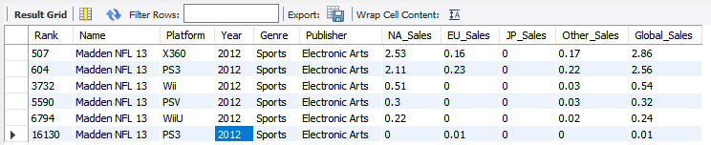
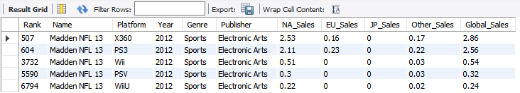
Data Processing (mySQL)
REMOVING DUPLICATES
Upon further inspection, we can see that row 16130 is the duplicate row;
SELECT *
FROM video_game_sales.vgsales
WHERE Name = 'Madden NFL 13'
Deleting row 16130;
DELETE FROM video_game_sales.vgsales
WHERE Name = 'Madden NFL 13’ AND Global_Sales = 0.01
Double checking;
SELECT *
FROM video_game_sales.vgsales
WHERE Name = 'Madden NFL 13'

Slide 12
03
Data Analysis

Slide 13

Data Analysis - Sales
Looking at the average sales for each country:
SELECT
AVG(NA_Sales) AS NA, AVG(EU_Sales) AS EU, AVG(JP_Sales) AS JP, AVG(Global_Sales) AS Global
FROM
video_game_sales.vgsales
*Note: Sales are in millions of copies*
North America has the highest average sales (260,000), followed by Europe (140,000) then Japan (78,000).

Slide 14
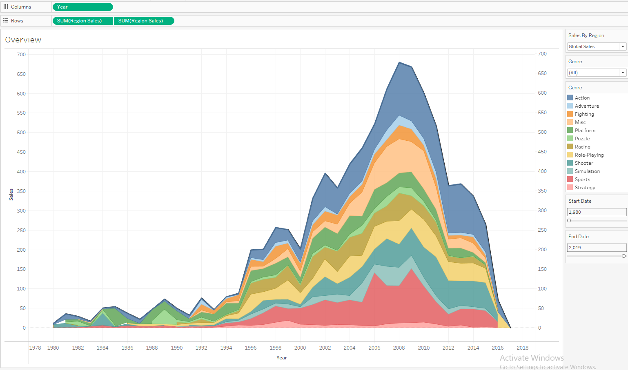
Data Analysis - Sales
Using Tableau, we can visualize the sales of video games by its Region, Genre & Year.
Tableau Live Link: https://public.tableau.com/views/VideoGameSales_16715481770100/Overview?:language=en-US&publish=yes&:display_count=n&:origin=viz_share_link

Slide 15
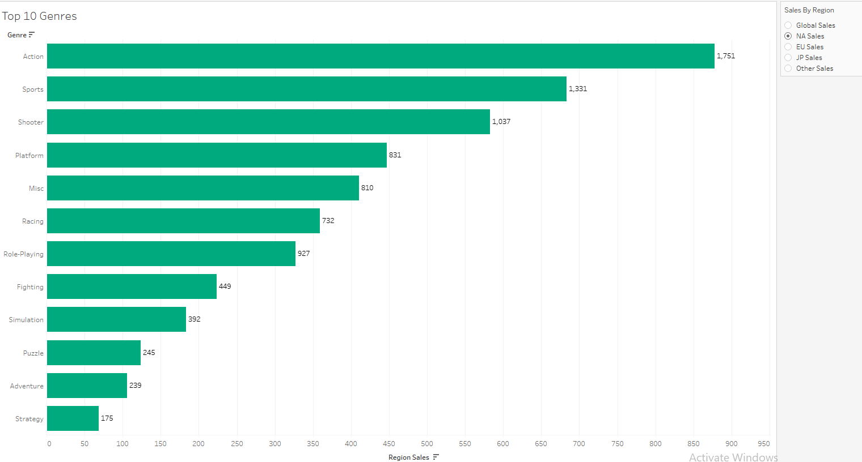
Data Analysis – Genre (NA)
Top 10 Genres in North America:

Slide 16
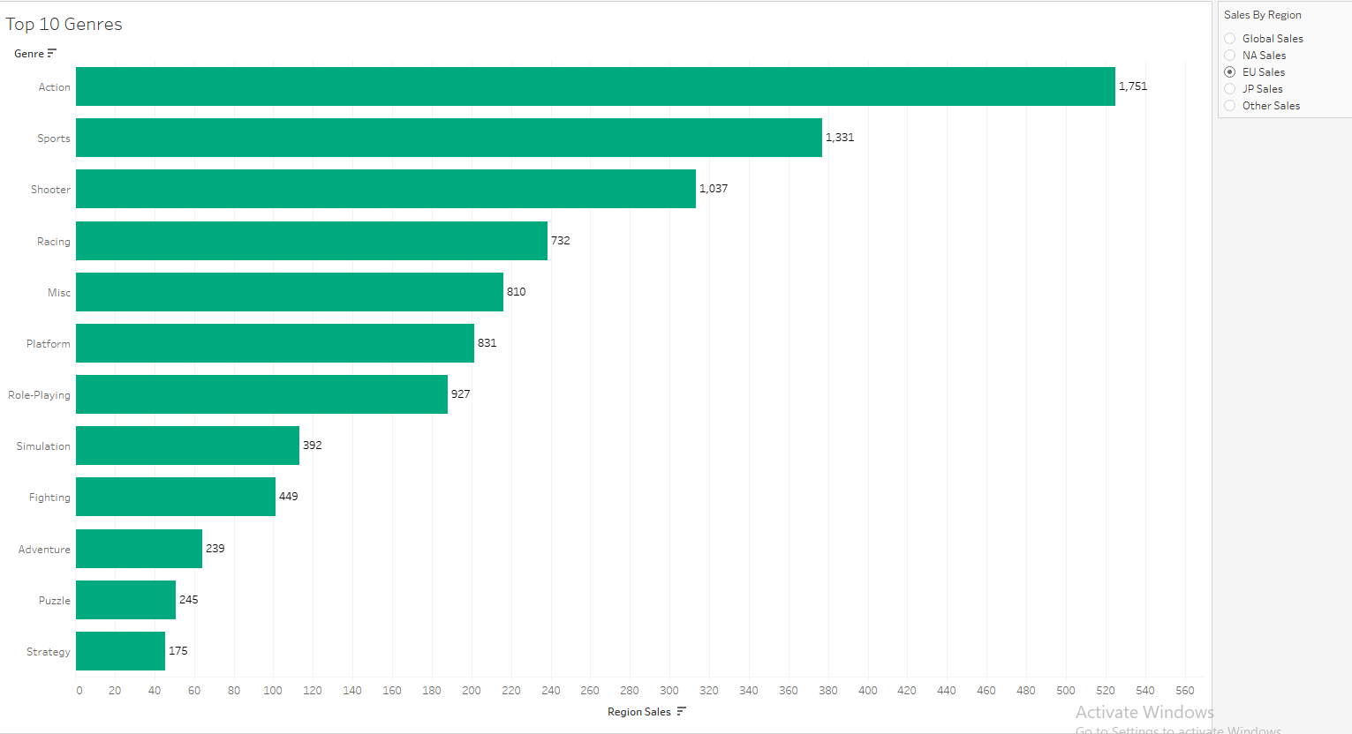
Data Analysis – Genre (EU)
Top 10 Genres in Europe:

Slide 17
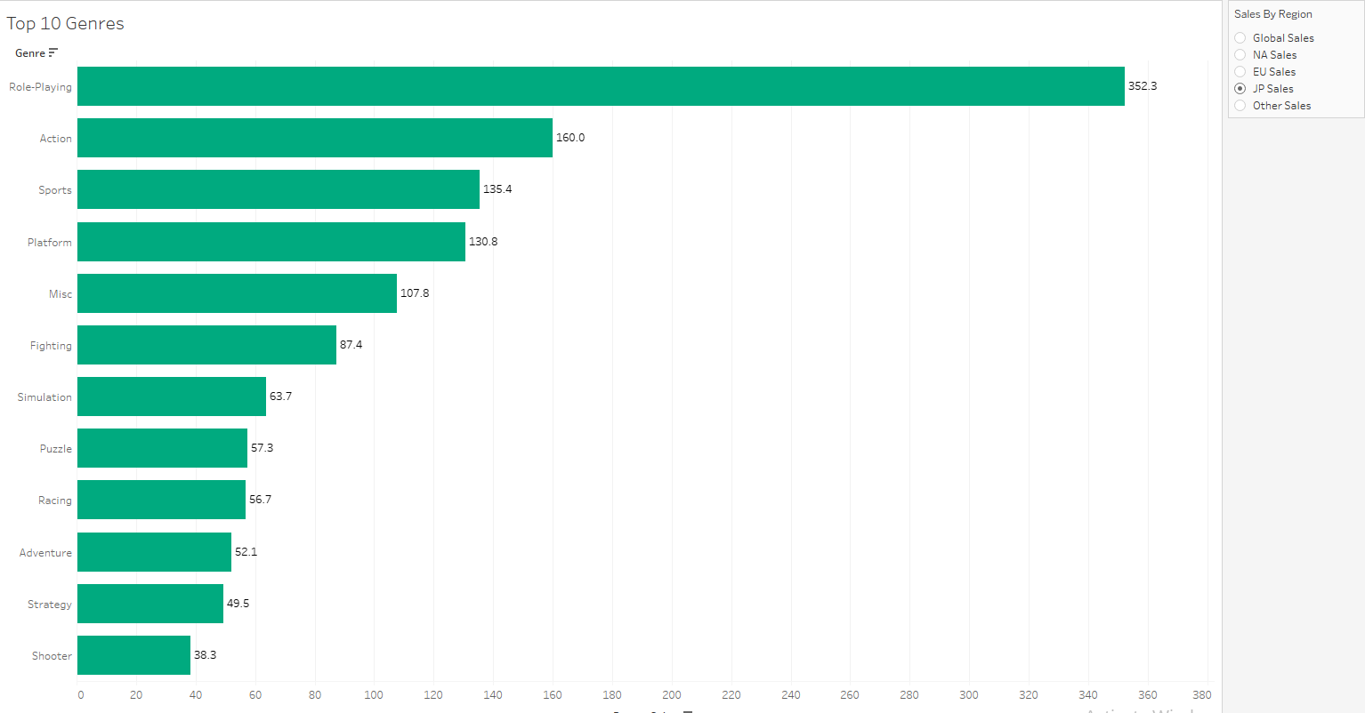
Data Analysis – Genre (Japan)
Top 10 Genres in Japan:

Slide 18
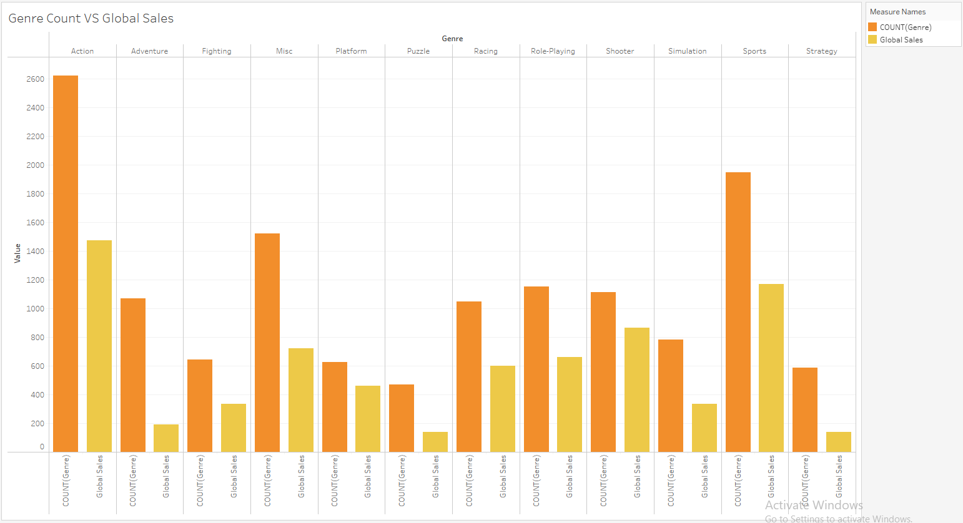
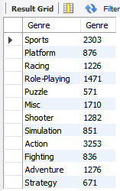
Data Analysis - Genre
Taking a deeper look by counting the Genres of each video game;
SELECT
Genre, COUNT(Genre) AS Genre
FROM
video_game_sales.vgsales
GROUP BY
Genre
We can tell that there is no direct correlation between the platform with the top sales and the greatest number of platforms.

Slide 19
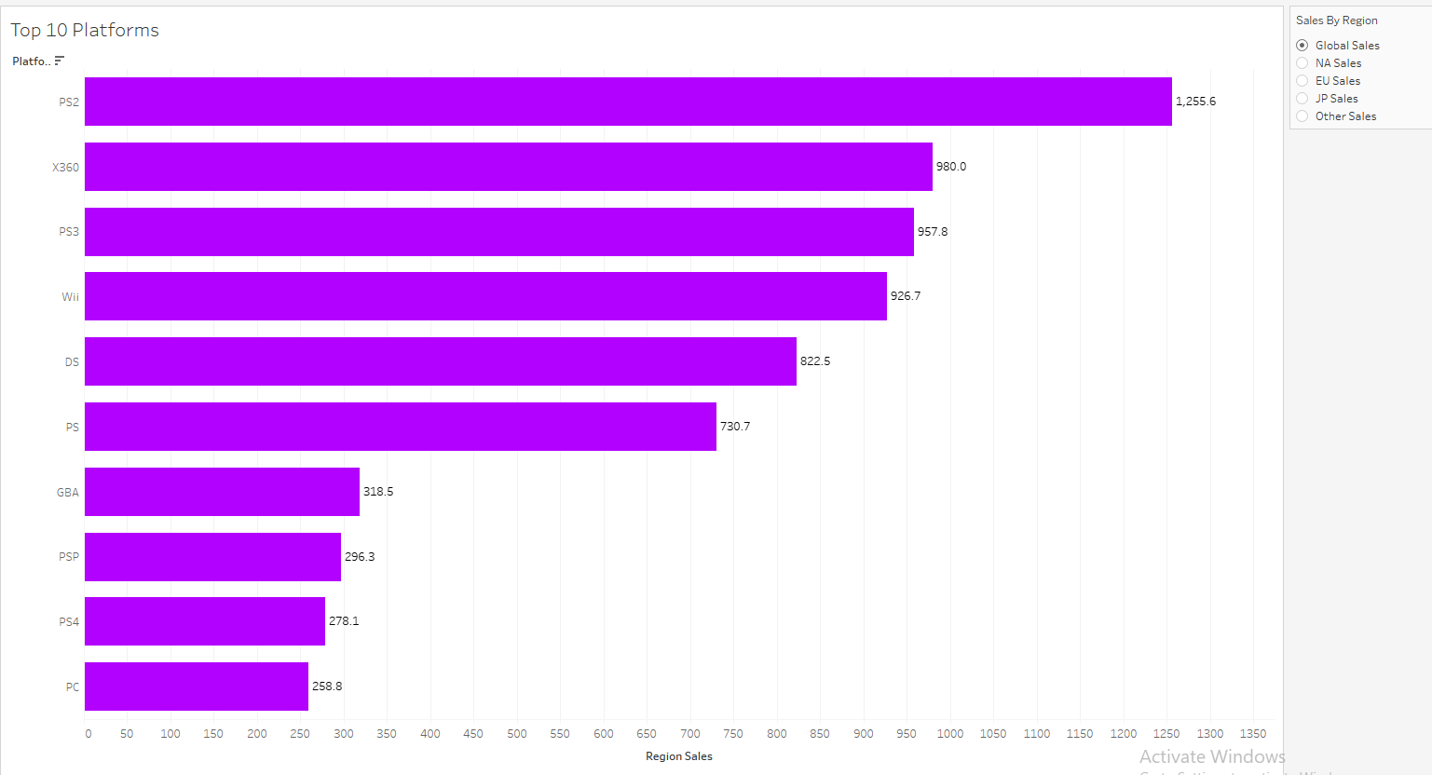
Data Analysis – Platform (Global)
The top gaming platforms are as follows:

Slide 20
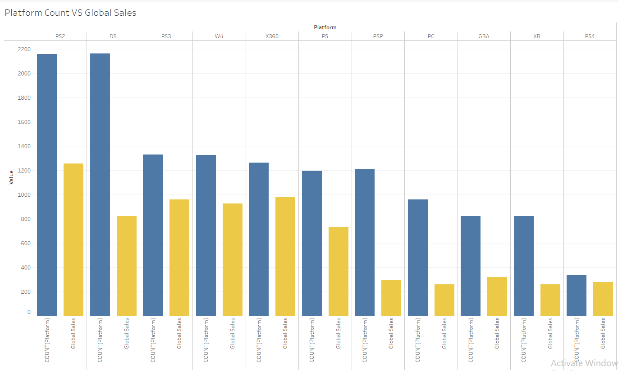
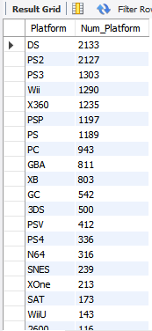
Data Analysis – Platform
Ordering by the Platform count;
SELECT
Platform, COUNT(Platform) AS Num_Platform
FROM
video_game_sales.vgsales
GROUP BY
Platform
ORDER BY
Num_Platform DESC
Unlike the video game genre, we can tell that there is no direct correlation between the platform with the top sales and the greatest number of platforms.

Slide 21
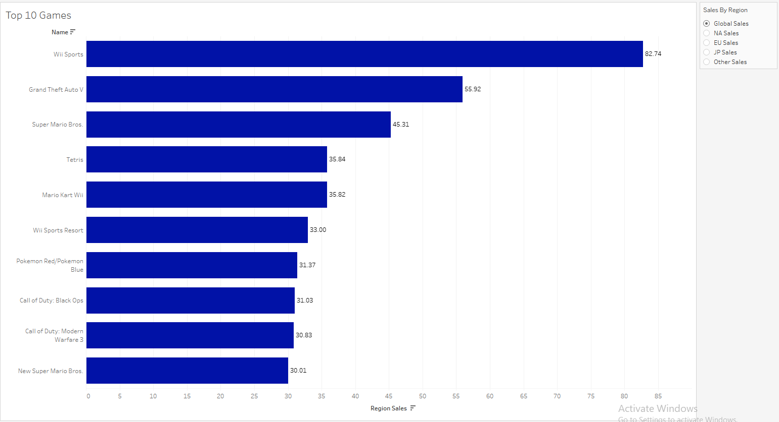
Data Analysis – Games
The top games are as follows (adjustable by region):

Slide 22
04
Insights & Recommendations
You can enter a subtitle here if you need it

Slide 23
Insights & Recommendations
GENRE:
For both NA and EU, we notice a similar trend in the top few favorite gaming genres, such as Action, Sports, Shooter etc. However, for Japan, a distinct difference in the top genre is the Role-Playing category.
Using this data, video gaming companies in Japan could perhaps focus on producing games under the role-playing category (MMORPGs - Massive Multiplayer Online Role-Playing Games, or MMOs) such as Genshin Impact, Maplestory etc., and vice versa for the other regions.

Slide 24
Insights & Recommendations
PLATFORMS:
The top gaming platform is the PS2, followed by XBOX360, PS3 & Wii. A possible reason for the PS2 being top could be that it has been around for a very long time, and many users have games which only the PS2 can play. Coupled with the fact that the new Playstation 5 is quite expensive, most users would prefer staying with their PS2.
A way to boost video game sales is to continue producing games which are playable and supported by the new PlayStations, as well as the older ones such as PS2.
However, if the aim is to boost the platform sales (such as PS5), the direction to look towards is to produce “Limited Edition” games that only the latest platforms can support. This might in turn boost the sales of the latest available gaming platforms.

Slide 25
Insights & Recommendations
SPECIFIC GAMES:
The most popular game is the Wii Sports, followed by Grand Theft Auto V and Super Mario Bros.
The Wii Sports is a category of its own which contains the different sports games playable by Wii, which could be why it has the most sales out of the other games. However, gaming companies could leverage on this fact by producing and creating more Wii Sports games which are even more interactive physically, which is one of the unique attribute of Wii Sports that attracts potential video gamers.
On the other hand, Grand Theft Auto V was a highly anticipated game with its multiple successive franchise in the past. Also, Grand Theft Auto V was released on multiple platforms – which is probably the main reason for its popularity. Building on this concept, video game companies could do the same by releasing a single game on multiple platforms to boost their sales and revenue.

Slide 26
Conclusion
By transforming raw data into clean and useful data using platforms such as Excel & SQL, we can create charts and visualizations out of it using Tableau.
With these visualizations, we can better understand the data presented to us, and make insightful recommendations to the relevant stakeholders, which could effectively boost their sales & revenue.

Slide 27
Thanks!
The End

